Slide 1
U.S. Small Business Administration Shuttered Venues Daily Report as of 12:00 pm ET May 3, 2021

Slide 2
Total Applications Received
22,538 Total
12,238 Started
10,300 Submitted

Slide 3
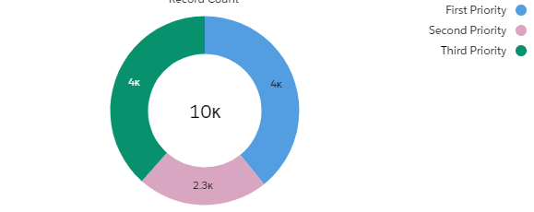
Breakdown by Priority Periods of Applications Submitted
4,041 First Priority
2,304 Second Priority
3,955 Third Priority*
*See notes for priority definitions
Notes:
First Priority (First 14 days of grant awards) –
Entities that suffered a 90% or greater gross revenue loss between April 2020 through December 2020 due to the COVID-19 pandemic.
Second Priority (Next 14 days of grant awards)-
Entities that suffered a 70% or greater gross revenue loss between April 2020 through December 2020 due to the COVID-19 pandemic.
Third Priority (Beginning 28 days after first and second priority awards are made) –
Entities that suffered a 25% or greater earned revenue loss between one quarter of 2019 and the corresponding quarter of 2020.

Slide 4
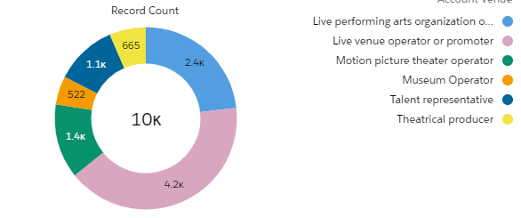
Breakdown by Venue Types of Applications Submitted
Applicant Venue
2,389 Live performing arts organization operator
4,227 Live venue operator or promoter
1,362 Motion picture theater operator
522 Museum Operators
1,135 Talent Representatives
665 Theatrical Producers

Slide 5
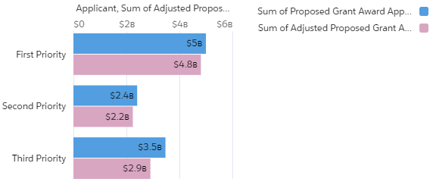
Total Requested Funding (Proposed & Adjusted) by Priority Period
PROPOSED
$10,874,936,794.69 Total
$4,998,773,357.50 First Priority
$2,404,310,439.05 Second Priority
$3,471,852,998.14 Third Priority
ADJUSTED (subtract post 12-27-20 PPP)
$9,953,899,713.43 Total
$4,809,051,663.83 First Priority
$2,240,891,379.17 Second Priority
$2,903,956,670.43 Third Priority*
*See notes for priority definitions
Notes:
First Priority (First 14 days of grant awards) –
Entities that suffered a 90% or greater gross revenue loss between April 2020 through December 2020 due to the COVID-19 pandemic.
Second Priority (Next 14 days of grant awards)-
Entities that suffered a 70% or greater gross revenue loss between April 2020 through December 2020 due to the COVID-19 pandemic.
Third Priority (Beginning 28 days after first and second priority awards are made) –
Entities that suffered a 25% or greater earned revenue loss between one quarter of 2019 and the corresponding quarter of 2020.

Slide 6
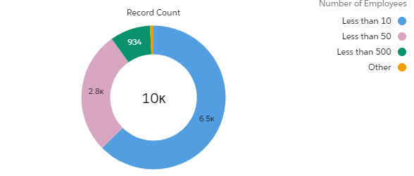
Applicants & Dollar Value that qualify for SVOG Small Business Set-Aside
Total Applications
9,288
Proposed Total
$10,874,936,794.69
ADJUSTED (subtract post 12-27-20 PPP)
$9,953,899,713.43
*See notes for priority definitions
Notes:
First Priority (First 14 days of grant awards) –
Entities that suffered a 90% or greater gross revenue loss between April 2020 through December 2020 due to the COVID-19 pandemic.
Second Priority (Next 14 days of grant awards)-
Entities that suffered a 70% or greater gross revenue loss between April 2020 through December 2020 due to the COVID-19 pandemic.
Third Priority (Beginning 28 days after first and second priority awards are made) –
Entities that suffered a 25% or greater earned revenue loss between one quarter of 2019 and the corresponding quarter of 2020.

